Slide 1


衡量結果
MEASURING
OUTCOME

Slide 2

FACILITATE THE GAM
E
This game is based on Evidence Based Management (EBM). EBM is an empirical framework organizations can use to help measure the (perceived) product value, and the way they deliver their product(s). The measurements can be inspected to help maximize product value and improve the way of working.
Scrum Facilitators is a Dutch-based training organization on a mission to help professionals become awesome Scrum facilitators. A Scrum Facilitator can be a Scrum Master, Product Owner, developer or leader. Great Scrum Facilitators understand the Scrum values & principles and use these to effectively implement Scrum with their teams and organizations.
Scrum Facilitators is a Scrum.org partner. Our classes are accredited, always up-to-date, fun, super interactive and always facilitated by two trainers to maximize your learning objectives. Our trainers are seasoned experts and Scrum.org certified Professional Scrum Trainers with substantial real life experience in various settings.
As a Scrum Facilitator, put the four Key Value Areas (KVAs) in a row on the floor (Current Value, Time to Market, Ability to Innovate and Unrealized Value). Explain each KVA to the participants.
Form two groups and hand one group the green Key Value Measures cards (KVMs) and the other group the remaining purple KVMs.
Step 1: Invite the group(s) to discuss and put the KVMs under the correct KVA.
Step 2: Invite both groups to discuss their results and adapt their cards. Make sure by the end of this round, the KVM cards are under the correct KVA.
Step 3: Invite the participants to individually look at the KVMs and select one KVM that caught their attention. (A non-EBM KVM may also be chosen at this point)
Step 4: Invite the participants into groups of four. Ask each participant to explain why they chose their particular KVM and collaborate on how to implement it. (In case of non-EBM measures, pay attention that these are not vanity metrics and discuss the potential pitfalls)
Learn about Evidence-Based Management (EBM) at http://scrum.org/EBM
The Measuring Outcome game (v1.0.2) is licensed under
CC BY-NC-SA 4.0
By Scrum Facilitators

Slide 3
Reveals the value that the product delivers to customers, today
目前價值
展示出產品在今日可提供給客戶的價值
CURRENT VALUE
Reveals the value that the product delivers to customers, today

Slide 5
上市時間
(產品)
表達組織快速傳遞新功能、服務或產品的能力
TIME TO MARKET
Expresses the organization’s ability to quickly deliver new capabilities, services, or products

Slide 7
創新能力
展現組織提供可能更好地滿足客戶需求的新功能的有效性。
ABILITY TO
INNOVATE
Expresses the ability of a product development organization to
deliver new capabilities that might better meet customer needs

Slide 9
未實現價值
當組織滿足所有潛在客戶或使用者的需求時可以實現的潛在未來價值
UNREALIZED VALUE
Suggests the potential future value that could be realized
if the organization could perfectly meet the needs of all potential customers

Slide 11
客戶滿意度
Customer Satisfaction

Slide 13
功能使用率指數
Feature Usage Index

Slide 15
缺陷趨勢
Defect Trends

Slide 17
產品成本率
Product Cost Ratio

Slide 19
安裝版本指數
Installed Version Index

Slide 21
建置和整合頻率
Build & Integration Frequency

Slide 23
生產事故趨勢
Production Incident Trends

Slide 25
發佈穩定期
Release Stabilization Period

Slide 27
市場份額
Market Share

Slide 29
客戶週期時間
Customer Cycle Time

Slide 31
學習時間
Time-to-Learn

Slide 33
員工滿意度
Employee Satisfaction

Slide 35
客戶使用率指數
Customer Usage Index

Slide 37
員工平均營收
Revenue per Employee

Slide 39
發佈頻率
Release Frequency

Slide 41
平均維修時間
Mean Time to Repair

Slide 43
交付時間
Lead Time

Slide 45
創新率
Innovation Rate

Slide 47
產品指數
On-Product Index

Slide 49
技術債
Technical Debt

Slide 51
活躍產品（代碼）分支 /
分支之間花費的時間合併代碼
Active (Product) Code Branches /
Time Spent Merging Branched Code

Slide 53
內容切換花費的時間
Time Spent Context-Switching

Slide 55
客戶或用戶滿意度差距
Customer or User Satisfaction Gap

Slide 57
不要衡量產出
衡量結果
Don’t measure Output. Measure Outcomes

Slide 59
這不是關於指標， 而是關於溝通
It’s not about the Metrics, but about the Conversation

Slide 61
想要了解更多
Evidence Based Management
請見
http://scrum.org/EBM

Slide 63
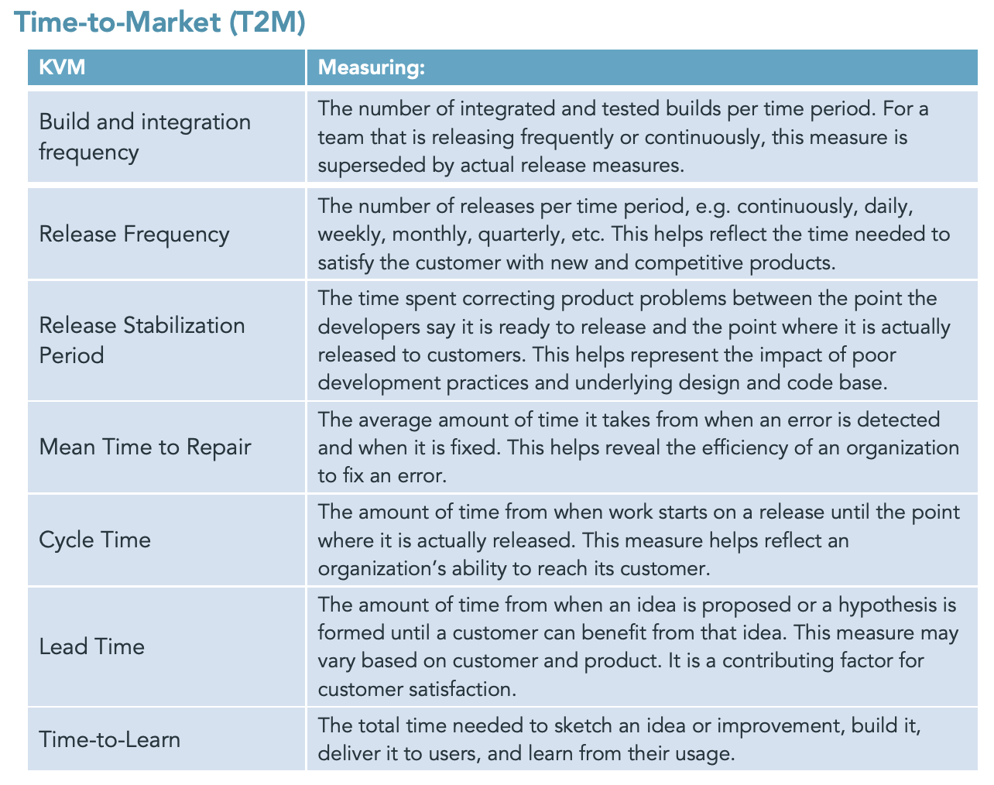
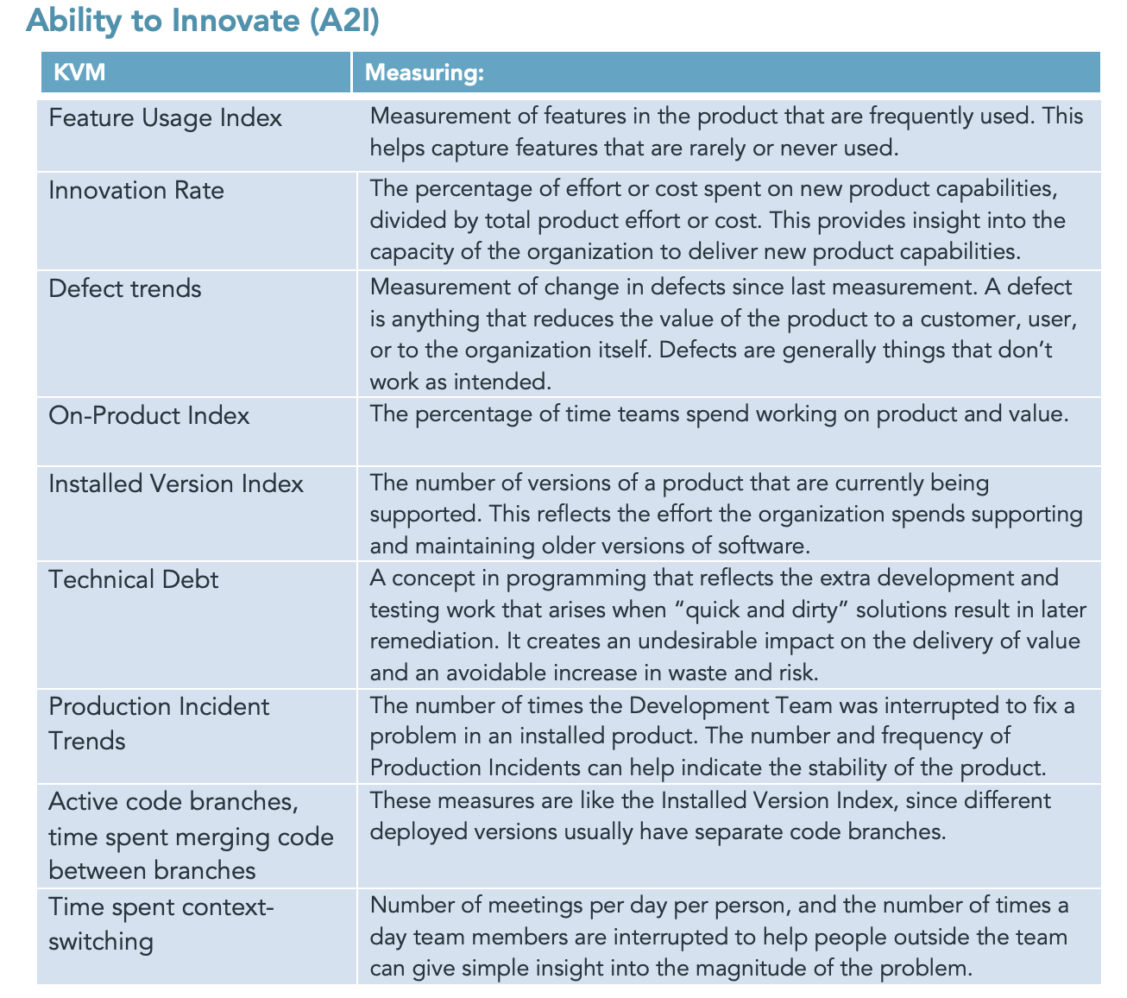
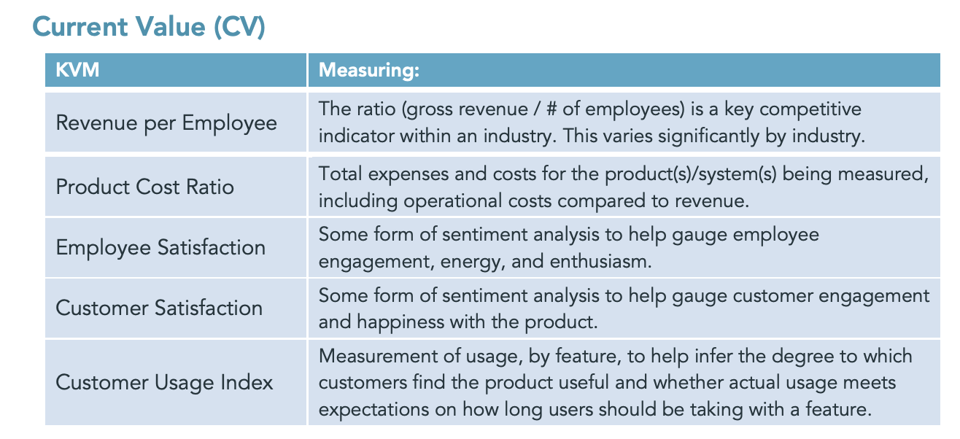
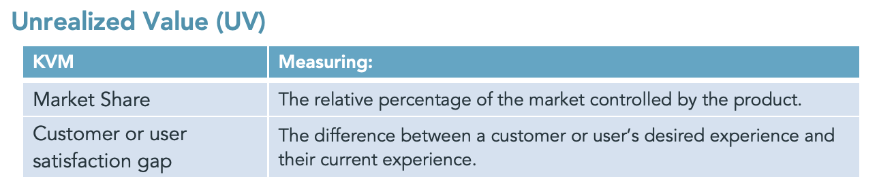
EBM suggested cheat sheet
Source: EBM guide, http://scrum.org/EBM

